Slide 1
Highland Christian Center
Congregational Meeting
Feb 5th, 2023
Love, Integrity, & Faith

Slide 2
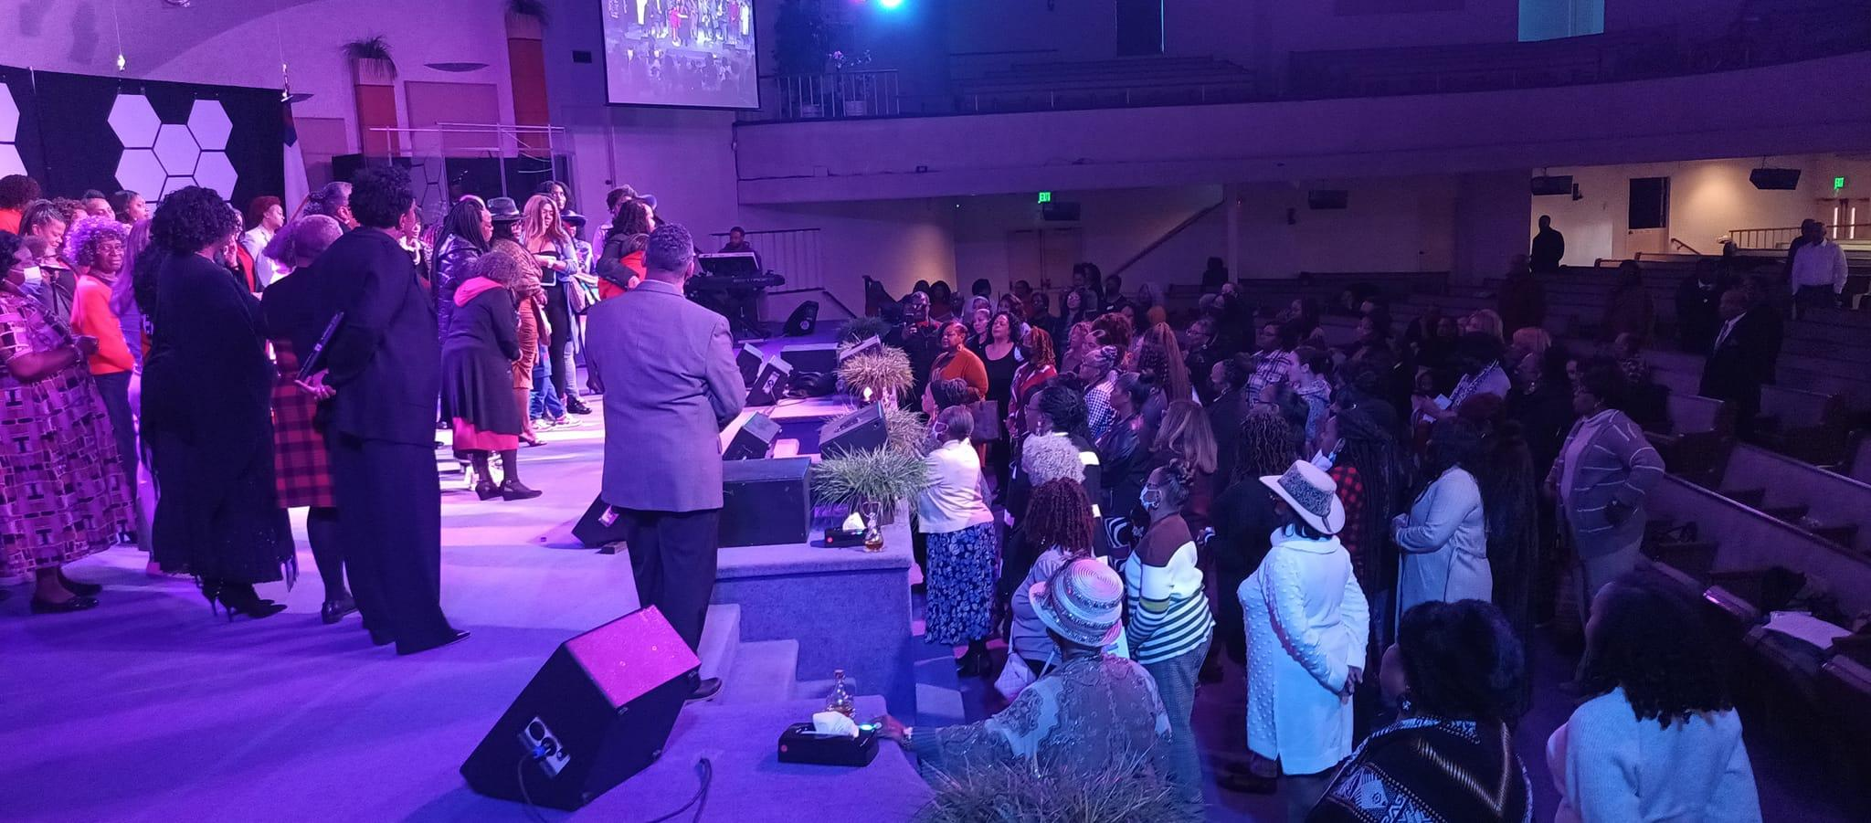
Greetings…
Ask your neighbor how many years they have been a member at Highland Christian Center?

Slide 3
Agenda
Introductions
Opening Remarks and Prayer
Pastors Remarks
2023 Executive Board Focus Areas
Year End Report
Open to the Congregation
Close

Slide 4
Pastor’s Remarks
21st Century Ministry of Excellence
Purpose in Mission: Increase membership/attendance to 500+ weekly (Dec 2023) through Four (4) Key Biblical Elements (Acts 2:42 – 47): Teaching of the Word; Breaking of Bread; Fellowship; and Prayer
Purpose in Education: Launch of the HCC Bible Institute, Fall 2023; In Partnership with Highland Haven (Preschool & Academy), launch Fall 2023
Purpose in Facilities: Complete major renovations no later than Spring 2023: White House; Mold Rebuild; and Apartment Renovations
Purpose: Provide life-giving skills to enable believers to live to the fullest capacity.
Purpose in Staffing: Hire Executive Pastor; Operations Manager/Pastor; Worship and Arts Director; Drummer; Praise and Worship Leader; and Youth Leader--Focus on Youth Growth
2023, “The Year of Purpose” All Ministries
We are a Bible-centered, multicultural community church, empowered by the Holy Spirit and committed to discipleship to reach the lost and impact the world for Christ.

Slide 5
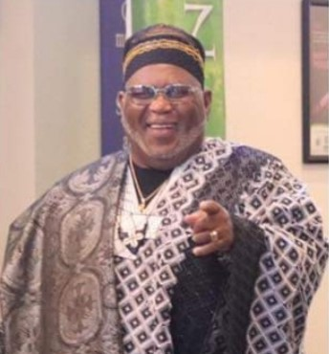
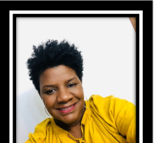
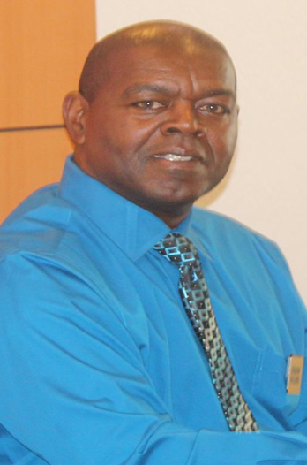
Pastor’s Appointees
In Accordance with HCC Bylaws, we request the congregation affirm the following pastoral appointees:
Elder Curtis Miller Elder/Pastor Yolanda Roseby Deacon Alvin McClure
Elders’ Director Women’s Director Head Deacon
If you there are any concerns to the appointments, please email Pastor Neyland at sneyland@hcclive.com

Slide 6
2023 Focus Areas
People, Process and Systems Improvement
Committee Appointments: Finance and Governance
Financial Accountability
Bylaws Review
Notes:
People, Process and Systems Improvement will require the senior management team, the board and the ministry all working towards the vision of HCC – Purpose Driven. Building a bible centered, purpose driven multicultural worship center empowered by the Holy Spirit, committed to discipleship, reaching the lost and impacting the community and the world for Christ. ( Article III HCC Bylaws). Role clarity between the various teams and better even distribution of the workload will help everyone serve at their best. This is a priority to set right in the next 90 days.
Committee Appointments. The Executive Board has two very important committees that support the church in overall functioning. 1) Finance Committee 2) Governance Committee. The Finance Committee is appointed by the Executive Board and includes 3 congregational members and 1 senior management representative. This committee is now chaired by our Treasurer John Miles. We will be seeking to replace members of this committee who have served longer than 2 years. The Governance Committee is chaired by our new VP ( Name new VP). The committee includes 3 congregational members and the Executive Board VP. I may attend some of these meetings as needed as will the Executive pastor. We are also looking to replace any committee members who have served longer than 2 years. We have some very dedicated members who have served on these committees tirelessly and have agreed to stay on until replacements can be made. If you have expertise or interest, please email Jasmine Hudson.
Financial Accountability – John Miles to discuss the importance of financial accountability. Any budget questions overall can be mentioned here. If the vote does not pass mention the need to review feedback, make adjustments if required and revote. We are focused on making the best financial decisions in a timely manner – focused on reinvestment of dollars into our overall mission. Mention the Capital Campaign as well.
Bylaws – The HCC Bylaws are currently under review by the Governance Committee and will come back to the congregation for a vote later in the year. The Bylaws were last updated in 2020 and will need a revision this year to clarify the way we govern the church together. Anticipate late spring 2023.

Slide 7
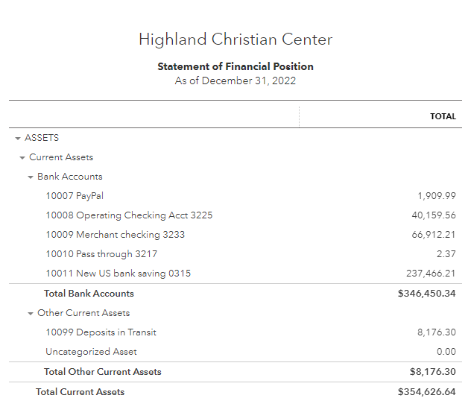
HCC Year End Financial Highlights

Slide 8
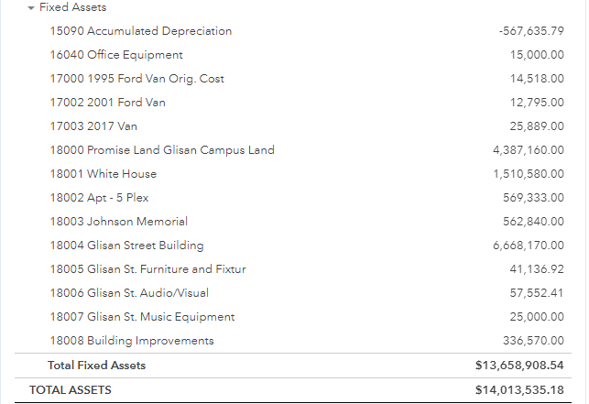
HCC Year End Financial Highlights

Slide 9
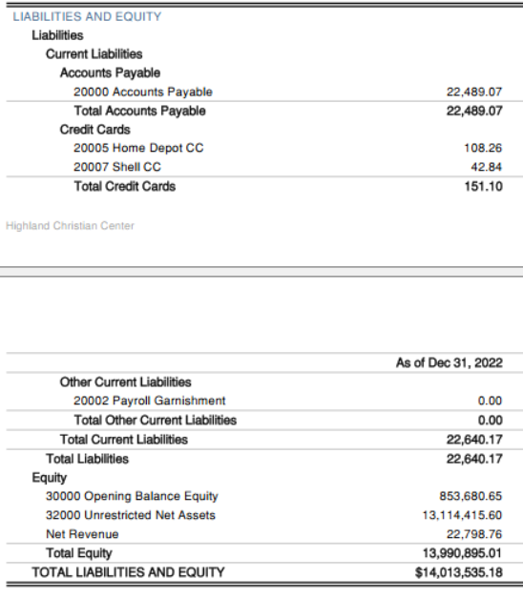
HCC Year End Financial Highlights

Slide 10
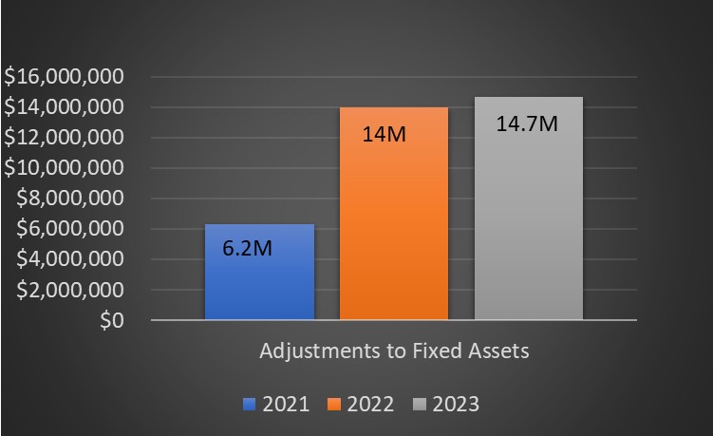
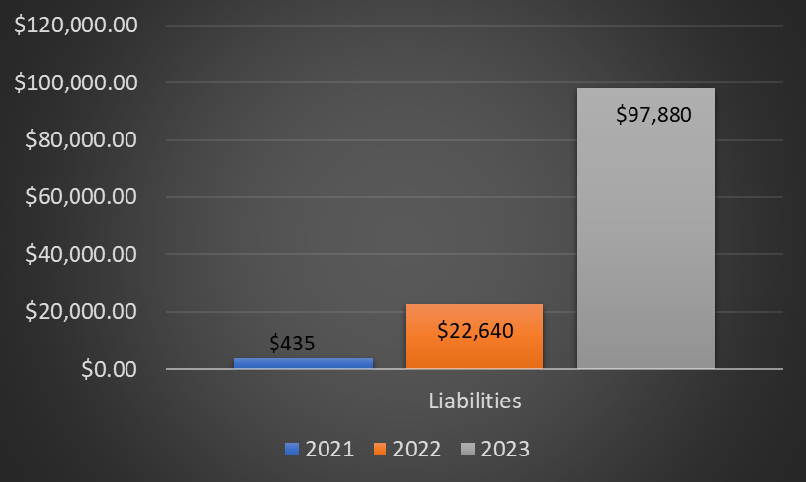
Year to Date Highlights
Employee Retention Credit: $28,000.00
Amount being placed in savings:12.5k, bringing the reserve account to ~250k
Income Category | 2021 Actual | 2022 Actual | 2023 Projected | Comment
Adjustments to Fixed Assets | $6,289,623 | $14,013,535 | $14,700,000 | Fixed Asset value is projected to increase following construction
Liabilities | $435.33 | $22,640.17 | $97,880 | (rollover Construction expenses from 2022)
2022 Actual includes Jan-Dec 2022
Key Message:
Liabilities increased in 2022 due to unforeseen maintenance requirements such as mold mitigation along White house and Over-hang renovations.
Renovation have aided in increasing the fixed asset values

Slide 11
2023 INCOME BUDGET vs HISTORICAL
Income Category | 2021 Actual | 2022 Actual | 2023 Projected | Overall Trend
Tithes & Offerings | $564,390 | $546,206 | $576,000
Rental Income | $136,933 | $162,612 | $193,108
Total Income | $701,323 | $708,818 | $769,108
2022 Income includes
Actuals Jan-Dec 2022
Key Message:
HCC Income mainly driven by Tithes & Offerings and rentals
Tithes & Offerings are flat while rental income is trending up YoY.

Slide 12
2023 EXPENSE BUDGET
Payroll: 45%
Operations: 35%
Ministry: 20%

Slide 13
2023 BUDGET
Category | Amount
Payroll | $ 400,649
Operations | $ 315,186
Christian Education | $ 7,700
Elders's Council | $ 9,990
Evangelism | $ 19,950
Children & Youth | $ 20,300
Family Life | $ 13,300
Women | $ 27,850
Worship & Arts | $ 19,950
Communications | $ 21,215
Pastoral Care | $ 39,400
TOTAL | $895,490
Remaining Reserve Funds : $250k ~ 4 months cash on hand

Slide 14
Open to the Congregation
Please use the microphones in the aisles to come up and ask questions or offer remarks. Please limit comments to 1-2 minutes.

Slide 15
Appendix

Slide 16
Budgeted Expense Approval Process
Approved 2023 Line Item Budget
Submit Purchase Request (PR)(Ministries and Operations) using Line Item Budget
Executive Director Signs/Approves Request
Executive Pastor Signs/Approves Request
Account Payable Specialist places PR in DOKKA for Processing
Executive Pastor goes into Milio for final Approval to Release Funds

Slide 17
Non-Budget Expense Approval Process
Submit Purchase Request (PR)(Ministries and Operations)
Requests over $1K submitted on Finance Spreadsheet and notification sent to FC for review. Ops approves up to $4K per mth.
Finance approves those requests sent to them and Executive Director Signs/Approves Request
Executive Pastor Signs/Approves Request
Account Payable Specialist places PR in DOKKA for Processing
Executive Pastor goes into Milio for final Approval to Release Funds
Notes:
Redesign process - maximum allowance per month $2000.00

Slide 18
DRAFT Budget Submission Process
Highland Christian Center budgets are developed to support our mission to build community and change lives.
Process:
Fixed expenses will be outlined based on 2022 actuals.
Each Ministry division leader will submit a budget justification for 2023. Forms will be provided.
Historical spend information will be shared based on average expenses from 2019 to 2022 (4 year average).
A budget total will be set and ministry divisions will justify expenses within the total planned spend.

Slide 19
Budget Submission and Approval Timeline
Monday Feb 13th - Finance Committee Meeting to review process. (Completed)
Tuesday Feb 21st - Finance Committee will meet with Executive Directors and request budget justification/adjustments.
Wednesday Feb 22nd – Saturday March 4th – Finance Committee and Operations work on Final budget for submission.
Friday March 3rd - Budget justifications due to Finance Committee for review.
Sunday March 5th - Congregation sent Final Budget for review and Notification of Vote planned for March 19th.
Monday March 6th through Saturday March 11th - Finance Committee decisions on budgets submitted.
Sunday March 12th- 2023 Budget DRAFT sent to congregation. Paper copies available. Finance Team available to Congregation for review after church Q &A.
Monday March 19th - Congregation vote begins online and in person - 1000am.
Sunday March 26th - Voting ends online and in person at 12noon.
Sunday April 2nd - Voting results announced.

Slide 20
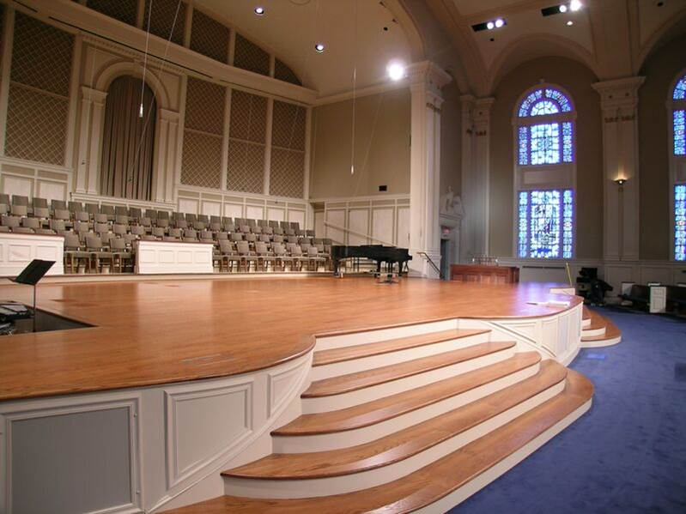
Capital Campaign
Target: 100K or more
Purpose: Sanctuary Renovations (New Pews and Flooring in Sanctuary, Atrium, and Fellowship Hall)
Campaign Challenge: 1k for 100 members (Need 96 more commitments)
Campaign Events: Valentine’s Dinner, Fish Dinners, etc.,

